Slide 1
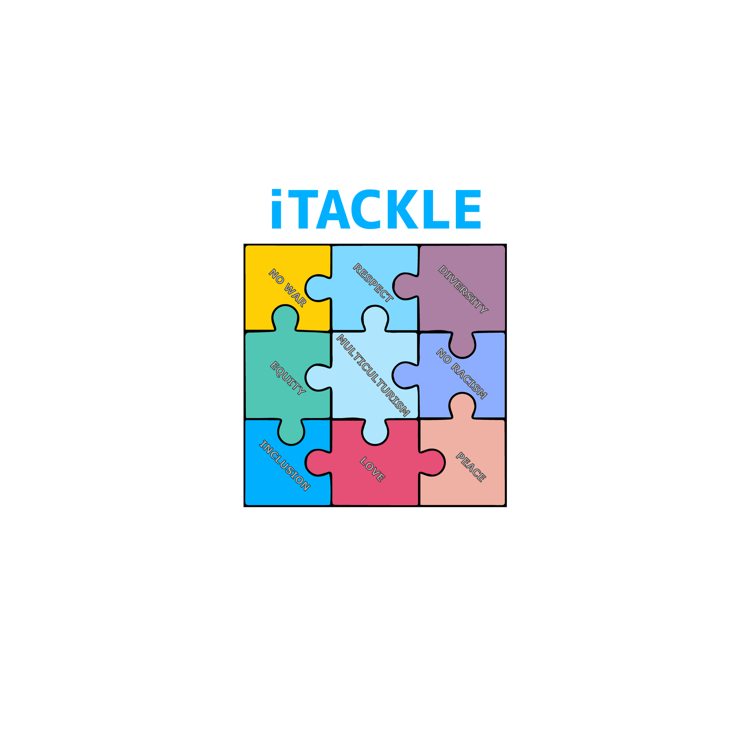


Project Presentation
Shaping the European Active Citizen: Raising intercultural / transcultural awareness through life skills cultivation in primary education
No. 2023-1-EL01-KA220-SCH-000158723

Slide 2
31 Oct. 2026
iTACKLE a 3 years project
2025
Project Coordinator: National and Kapodistrian University of Athens (NKUA), Greece
Project Number:2023‐1‐EL01‐KA220‐SCH‐000158723
Program: Erasmus+ ΚΑ220 SCH - Cooperation Partnerships In The Field Of School Education
2024
1 Nov 2023

Slide 3



Project Overview
The iTACKLE project aims to cultivate Active European Citizens (AEC) by fostering intercultural and transcultural awareness through innovative, competence-based education designed for primary school pupils. By laying the foundation for transformative education and active citizenship, the initiative helps shape a more cohesive and inclusive Europe.
Main Goal
To address pressing societal challenges by equipping pupils aged 9-12 with essential life skills, enabling them to:
  Embrace European values such as democracy, justice, equality, and human rights.
  Develop intercultural competence, tolerance, and acceptance.
  Strengthen critical and creative thinking and participate actively in democratic processes.
Vision
Through inclusive and innovative educational programs, iTACKLE aims to create environments where every pupil thrives, regardless of background, preparing them to positively contribute to multicultural societies.

Slide 4
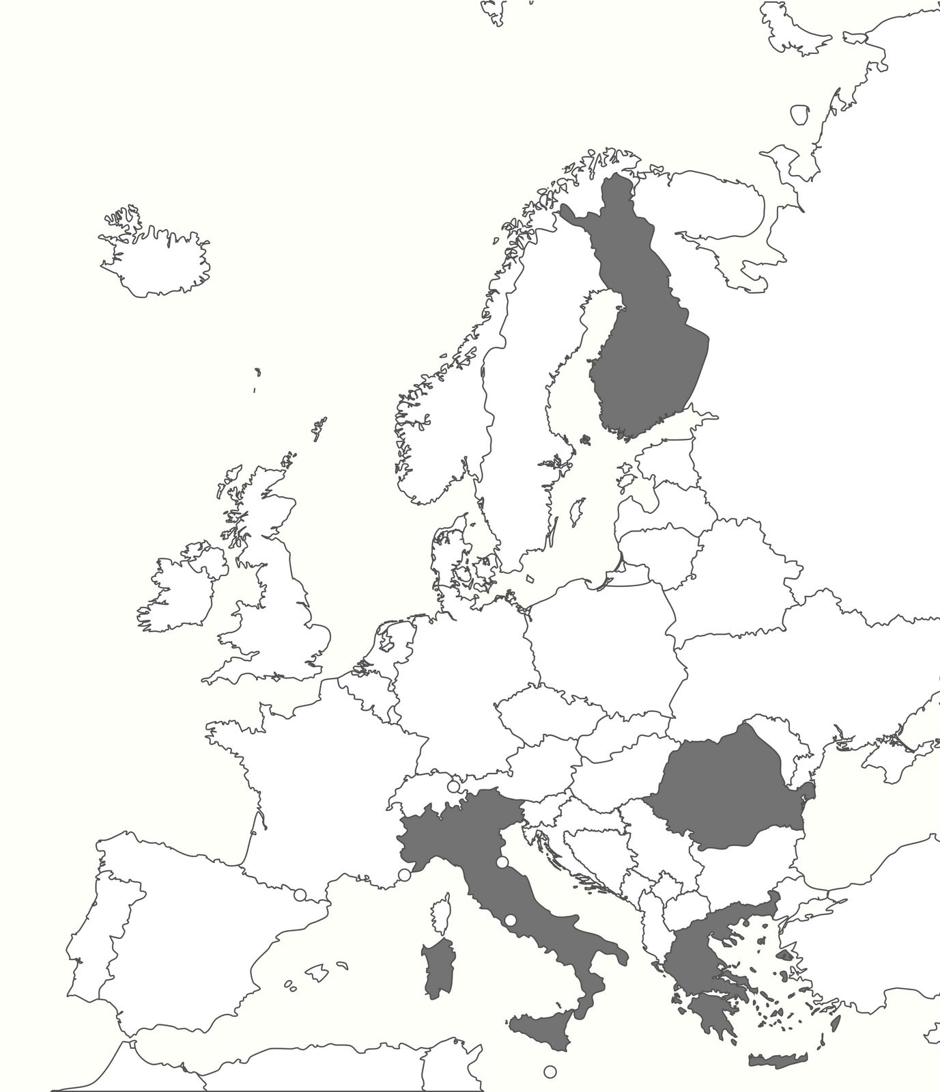




iTACKLE Consortium
5 partners from 4 Countries
  National and Kapodistrian University of Athens (NKUA)
  Creative Thinking Development (CreThiDev)
Inspectoratul Scolar Judetean Timis (ISJ_TM)
Istituto Omnicomprensivo Giano Dell'Umbria – Bastardo (ISTITUTO)
Olemisen Balanssia ry (OLEMISEN)

Slide 5
IDENTIFIED NEEDS
Declining Civic Engagement | Lower voter turnout and political participation, especially among youth, highlight the need for early civic education.
Limited Intercultural Skills | Multicultural societies require better understanding and engagement with diverse cultures.
Social Inequalities & Discrimination | Structural barriers, xenophobia, and racism limit equal participation in society.
Gap in Life Skills Education | Empathy, critical thinking, and adaptability are undervalued in curricula.
Inconsistent Educational Standards | Variations in teacher training and citizenship education hinder cohesive civic development.

Slide 6
PROJECT OBJECTIVES
Develop Active European Citizenship & Intercultural Competence
Empower Educators & Engage Communities
Promote Inclusive & Innovative Education
Share Best Practices for Inclusion
Promote democracy, human rights, equality, and tolerance while equipping students for multicultural engagement through respect and cooperation.
Develop programs addressed the diverse needs of all students, including disadvantaged and migrant, while fostering empathy, problem-solving, and emotional management through experiential learning.
Provide training and resources for inclusive teaching while involving parents and communities to strengthen shared values and social cohesion.
Disseminate effective strategies, tools, and methodologies for life skills development and active citizenship across Europe.

Slide 7




Target Groups
Primary Beneficiaries
Secondary Beneficiaries
Pupils aged 9-12
Educators &
Teachers
Parents &
Guardians
Community

Slide 8




Training Curriculum on AEC for Educators A structured program empowering teachers with skills for multicultural classrooms, active citizenship, and innovative teaching. | Training Curriculum on AEC for Parents/Guardians A tailored program engaging parents in the educational process to reinforce life skills and intercultural competencies, fostering collaborative learning at home and in the community. | Toolkit for Educators & Pupils A practical set of resources including an educator's guide, project materials, and a pupil's workbook with activities designed to foster skills, encourage active citizenship, and promote inclusion. | Gamified Software An interactive, game-based learning tool developed for pupils aged 9–12. It aims to foster engagement and enhance the acquisition of life skills, intercultural competence, and active citizenship in a playful and immersive environment. | Policy Recommendations' Report A comprehensive compilation of actionable policy recommendations to foster intercultural awareness, life skills, and social inclusion within the education sector.
5
MAIN OUTPUTS
4
3
2
1
5 Main Outputs

Slide 9
ADDED VALUE
Pupils: Gain essential life skills like adaptability, empathy, and critical thinking, preparing them for democratic and social participation.
Parents: Actively engage in their child's education, fostering a supportive home environment that complements school learning.
for the Target Groups
Educators: Access innovative teaching tools to manage diverse classrooms and support professional growth.
Social Cohesion: Promotes inclusion by addressing inequalities, fostering respect, and reinforcing shared European values.
Democratic Engagement: Encourages active citizenship, critical thinking, and meaningful participation in democracy.
Future-Ready Skills: Prepares individuals for a globalized world through collaboration, problem-solving, and adaptability.
for the Community

Slide 10


THANK YOU
Disclaimer
Funded by the European Union. Views and opinions expressed are however those of the author(s) only and do not necessarily reflect those of the European Union or the Hellenic National Agency (IKY). Neither the European Union nor IKY can be held responsible for them.
All rights are reserved.
Copyright © iTACKLE Consortium, 2023-2026
No. 2023-1-EL01-KA220-SCH-000158723
2023 - 2026

